Slide 1
Phase 1: Classification Problem
Breast Cancer Diagnosis | ML Group Project (Fall 2025-2026)
Ma’moun Hussam Yosef – 0233493 (Team Leader)
Ahmad Hani Habab - 2213575
Hazim Majdi Alazab - 0222280

Slide 2
Dataset Selection & Overview
• Dataset: Breast Cancer Wisconsin (Diagnostic) Data Set.
https://www.kaggle.com/datasets/uciml/breast-cancer-wisconsin-data
With it’s Benchmarks:
https://archive.ics.uci.edu/dataset/17/breast+cancer+wisconsin+diagnostic
• Target: Diagnosis (M = Malignant, B = Benign).
• Features: 30 computed features (Radius, Texture, Area, etc.) from digitized images.
• Justification for the Choice:
• - Critical healthcare application where ML can save lives if an early cancer diagnosis were discovered.
• - Well balanced dataset with sufficient samples to train robust models.
• - Established benchmark in the ML community, allowing for comparison.

Slide 3
Preprocessing Pipeline
• Data Cleaning:
• - Dropped 'id' and empty 'Unnamed: 32' columns.
• - Verified that there is no null or missing values.
• Encoding:
• - LabelEncoder: Malignant (M) → 1, Benign (B) → 0.
• - Stratified Splitting: 80% Train, 20% Test.
• Feature Scaling:
• - StandardScaler (Z-score normalization).
• - Fitted on Train only to avoid data leakage.

Slide 4
Baseline: Logistic Regression Scores
• Model Config: Max Iterations = 1000.
• Test Set Results:
Avg F1-Score: 0.9619
Overall Accuracy: 96.491
AUC-ROC score: 0.996
Compared to the Benchmarks, the Avg Accuracy was 95.804 and a precision of 95.503
The running model on HuggingFace: https://huggingface.co/spaces/ML-Project-2025-for-dr-ali/breast-cancer-logreg
Matric | Class 0 (Benign) | Class 1 (Malignant)
Precision | 0.96 | 0.97
Recall | 0.99 | 0.93
F1-Score | 0.9726 | 0.9512

Slide 5
Advanced 1: Random Forest
• Approach: Ensemble Learning (Bagging).
Hyperparameter:
• - n_estimators: 30 (number of trees)
• - max_depth: 4 (to prevent overfitting)
• Results (Test Set):
Avg F1-Score: 0.9521
Overall Accuracy: 95.61
AUC-ROC score: 0.992
Compared to the Benchmarks, the Avg Accuracy was 97.902 and a precision of 97.940
Matric | Class 0 (Benign) | Class 1 (Malignant)
Precision | 0.946 | 0.974
Recall | 0.986 | 0.904
F1-Score | 0.9659 | 0.9382

Slide 6
Advanced 1: Hyperparameter Tuning (GridSearchCV)
Possible parameters to tune: (with F1-score as the considered matric)
n_estimators: [100, 200, 300]
max_depth: [None, 5, 10]
min_samples_split: [2, 5] (controls how many samples are needed before a node can split)
min_samples_leaf: [1, 2] (controls how many samples a final leaf must have)
Turns out that the best parameters are max_depth: None, min_samples_leaf: 1, min_samples_split: 2, n_estimators: 100}
With the Parameters turned the following scores increased:
- Accuracy increased from 95.61 to 97.36
- Avg F1-Score increased from 0.9521 to 0.9712
- AUC-ROC increased from 0.992 to 0.993

Slide 7
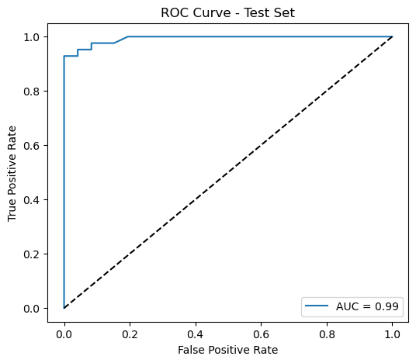
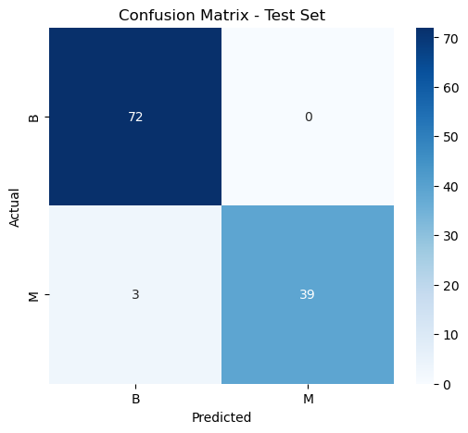
Random Forest visualization

Slide 8
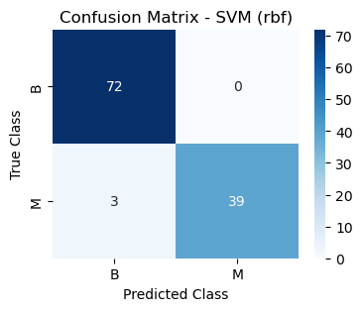
Advanced 2: Support Vector Machine
We tried different types of SVM karnels (linear, poly, rbf), turns out that for the default hyperparameters the RBF model scored the highest (The RBF model is good at separating non-linear patterns).
Matric | Class 0 (Benign) | Class 1 (Malignant)
Precision | 0.960 | 1.000
Recall | 1.000 | 0.928
F1-Score | 0.9795 | 0.9629
Avg F1-Score: 0.9712
Overall Accuracy: 97.368
AUC-ROC score: 0.992
Compared to the Benchmarks, the Avg Accuracy was 94.406 and a precision of 94.768

Slide 9
Advanced 2: Hyperparameter Tuning (GridSearchCV)
Possible parameters to tune: (with F1-score as the considered matric)
C : [0.1, 1, 10] (controls how much you penalize misclassifications)
gemma: [0.001, 0.01, 0.1] (controls how far each training point influences the decision boundary)
Karnel: [linear, rbf, poly]
Turns out that the best parameters are C: 10, gemma: 0.01, Karnel: rbf
With the Parameters turned the following scores increased:
- Accuracy increased from 97.368 to 98.246
- Avg F1-Score increased from 0.9712 to 0.9809
AUC-ROC increased from 0.992 to 0.996
These Findings show that Tuning hyperparameters is crucial because the right settings can significantly boost a model’s performance, as shown by the jump in accuracy, F1-score, and AUC-ROC after optimizing both the SVM and Random Forest parameters.

Slide 10
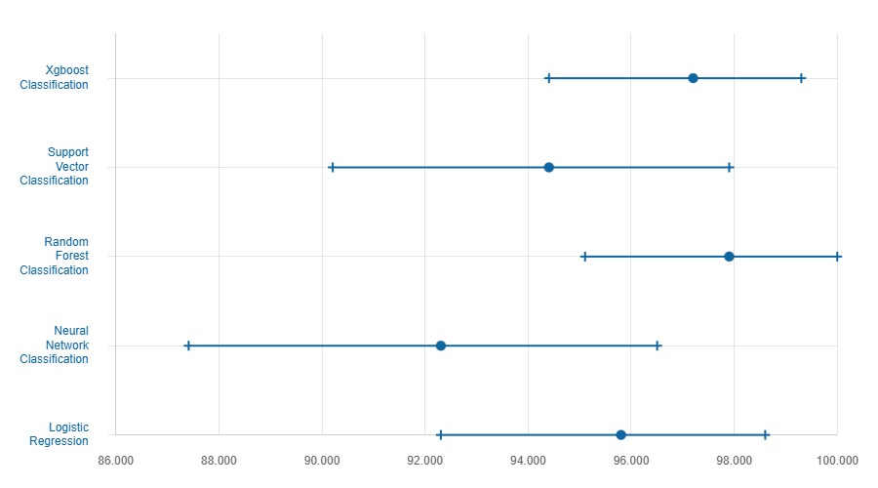
Benchmarks Accuracy for different Models

Slide 11
Comparative Analysis & Conclusion
Conclusion & Key Insights:
All models performed well on the breast cancer classification task.
Hyperparameter tuning improved results significantly.
The tuned SVM (RBF) achieved the best overall accuracy and F1-score.
• Final Recommendation:
• The Tuned SVM Model is recommended for deployment due to high Recall (minimizing dangerous false negatives).
The source code on Github: https://github.com/Mamoun77/ML-Classification-models

